Slide 1

LHL Capstone Project: The Geographical Distribution of Seniors in Nursing Homes Within the City of Calgary.
Presented by:
Chukwuemeka Alex Udekwu.

Slide 2
Goal
IDENTIFY THE GEOGRAPHICAL LOCATION OF NURSING HOMES BY QUADRANT WITHIN CALGARY AS WELL AS THE DEMOGRAPHIC DISTRIBUTION OF SENIORS IN THESE HOMES FOR EFFECTIVE SERVICE DELIVERY.

Slide 3
Data Dictionary
Senior: An elderly person that falls between the age range of 65years or older( As considered in Canada).
Nursing Homes: A multi residence housing facility intended for the elderly.
Quadrant: The four parts of a sphere divided by lines or planes at right angles.ie the four parts of Calgary having nursing homes situated in those areas.
Companions: Trained staff that care for the seniors.
Gender: The male sex or female sex.

Slide 4

Data Integration Process
To further elaborate on this project, the Extract, Transform and Load process (ETL) was utilized as the data integration process which is categorized under the following tools;
Extraction of data was carried out using Excel
Transformation and analyzing of data was carried out using Postgresql.
Loading of data(visualization ) was carried out using tableau.
Following the project flow, the extracted database was critically structured on excel sheet and cleaned to avoid leading to inaccurate conclusions. Afterwards the structured database was converted to csv files for easy interpretation and analysis using postgresql tool.

Slide 5

Analysis of Data
At the point of exploration of data and analysis, the following questions were asked, and possible answers deduced from the dataset.

Slide 6
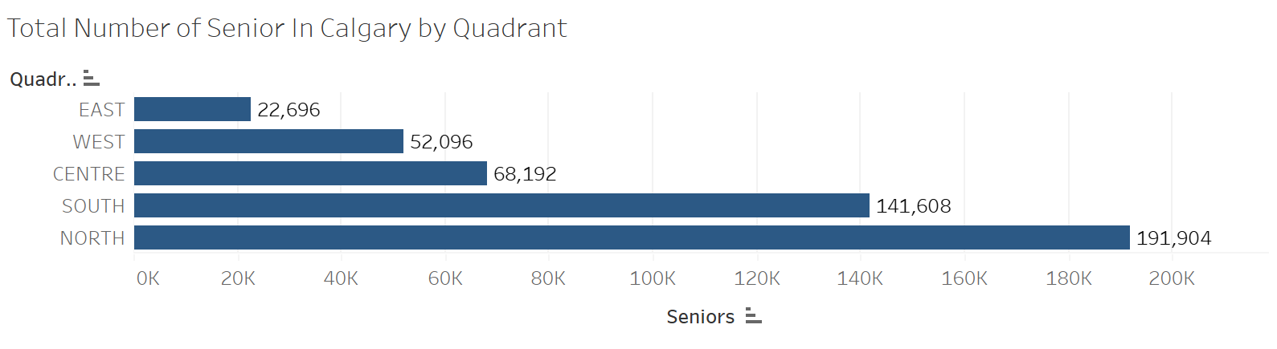
1. The total number of seniors in Calgary between the age range of 65-95 years and above using quadrants in 2022
Upon analysis, a total number of 476,496 seniors are residing within the quadrants of Calgary, which is about 29% of the total population in Calgary.

Slide 7
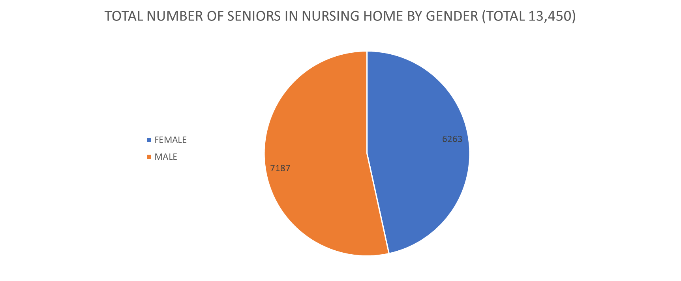
2. Total Number of Seniors in Nursing Homes
It was gathered that a total of 13,450 seniors of both gender which make up about only 3% of seniors in Calgary. By gender, record shows that the male make up to 53% of the total number of seniors in nursing homes.

Slide 8
3. The demographic distribution of seniors by age range and their location
It was thus gathered that seniors from 95years and above comprising of both gender occupy majority of nursing homes in Calgary recording a total of 5,316. This is because at this age, special care is needed to attend to their needs.

Slide 9

4. The distribution of seniors within the nursing homes by quadrant, categorized by their age range
From this analysis, it was deduced that the nursing home with more seniors at an average age of 87 years and above occupy most nursing homes in the southern part of Calgary. This is because some of the homes in the south provide extensive services for seniors with special needs.

Slide 10

Future goals
Once given the opportunity, I would like to explore several aspects of data relating to the :
Current trend in the demographic distribution of Seniors in nursing homes with regards to geographical location.
Analyze the factors that facilitate cross-demographic distribution of seniors such as Care facilities, Specialized departments, availability of companions to cater to the needs of these seniors in the nursing homes and wait time before companion’s service delivery.

Slide 11



Conclusion
While anticipating to explore further, this project has enabled me understand the demographic distribution of seniors in nursing homes located within Calgary.
Thank you all for listening.
I can answer any question relating to this presentation for further clarification.

